Slide 1
Berkeley’s Epistemology
George Berkeley
  Born in 1685 at Dysert Castle in Ireland.
  Elected a junior lecturer at Trinity College in Dublin in 1707.

Slide 2
  Wrote his most important philosophical works at Trinity from 1707 through 1713, during which time he was ordained an Anglican priest.
    Treatise Concerning the Principles of Human Knowledge (1710)
    Three Dialogues between Hylas and Philonous (1713)

Slide 3
  In 1728, having had a religious vision of an ideal society and having been promised funds by George I, he set out for Bermuda to found a college for the converting of the Indians to Christianity.
  A navigational error brought him instead to Newport, Rhode Island. He waited there for two years for the funds that the King had promised, but they never came.

Slide 4
  In 1734 he was named the Anglican Bishop of Cloyne in County Cork, Ireland.
  Spent the next eighteen years at Cloyne living a typical Anglican bishop’s life and writing a few undistinguished philosophical works
  Moved to Oxford, England in 1752 to be near his son, who was studying there.
  Died at Oxford in January, 1753.

Slide 5
Berkeley’s Critique of Locke
  Locke had distinguished between primary and secondary qualities because, he said, different people can perceive the latter differently but not the former.
  Berkeley says this is wrong. Different people perceive the so called primary qualities differently as well.
  Take, for example, shape.

Slide 6
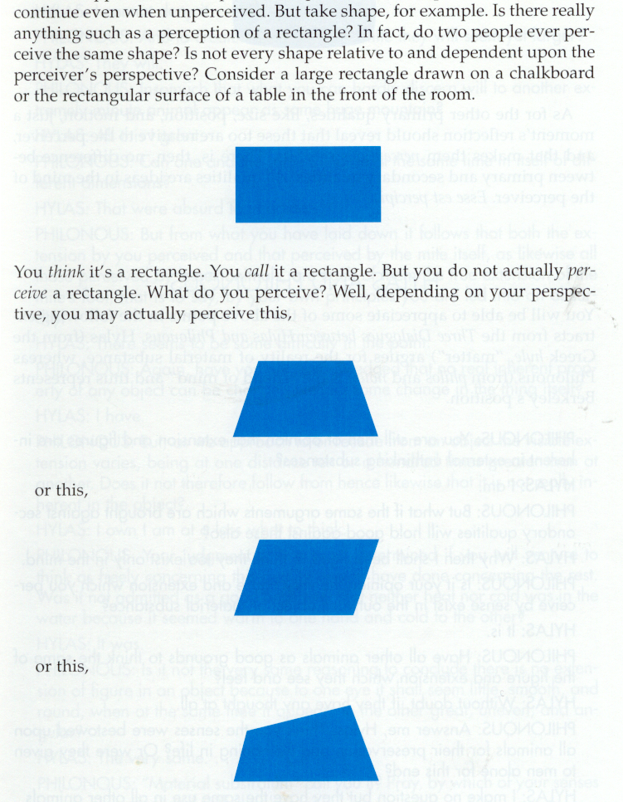

Slide 7
  Berkeley says the reason different people perceive the so called primary qualities differently is the same reason Locke gave for differing perceptions of the so called secondary qualities.
  Both “primary” and “secondary” qualities exist not in material objects but only in the minds of the perceivers.

Slide 8
Berkeley’s Idealism
  Berkeley’s critique of Locke leads him to what appears to be a shocking conclusion – there is no such thing as matter! There is no such thing as a material world.
  Given his Representational Theory of Perception, Locke conceded that humans do not directly perceive material objects, only the mental copies of them that exist in their minds.

Slide 9
  Material objects, however, are important to Locke’s epistemology because they are where the primary qualities are located, while the secondary qualities are located only in the minds of perceivers.
  Since Berkeley has destroyed Locke’s distinction between primary and secondary qualities and shown that all qualities exist only in the minds of perceivers, the justification for positing the real existence of material objects no longer exists.

Slide 10
  Sensible objects are real, but they are not material. Rather, they are complex ideas, complex “bundles” of sensible qualities (e.g. “Mr. Potato Head”).
  These bundles of sensible qualities exist only in the minds of perceivers.
  Esse est Percipi, i. e. “to be is to be perceived.”
  Sensible objects exist only so long as they are being perceived by some perceiver.

Slide 11
  “Wood, stone, fire, water, flesh, iron . . . are things that I know. And, I should not know them, but that I perceive them . . . [and the] things . . . perceived are ideas; and ideas cannot exist without the mind; their existence, therefore, consists in being perceived . . . .” (Berkeley, Three Dialogues between Hylas and Philonous)
  Since it is the mind that perceives, humans are simply minds without any material bodies.
  Thus, actually, there are two modes of existence for Berkeley – that which is perceived (sensible, non-material objects) and that which perceives (mind).

Slide 12
  General Form of Bishop Berkeley’s Arguments in First Dialogue
  Assume no legitimate ideas without sensations.
  Assume inferences from sensations to mind-independent entities as their causes are unwarranted.
  Notice the ‘mind-dependent’ features of any and all sensible qualities. (e.g., what is small for me is large for you, all I ever apprehend directly is in the mind, etc.)
  Note that if these sensible qualities are real properties of mind-independent objects, a) they must be unchanging and b) we must be able to know them.
  Note that by (I) and (II), sensible qualities are unknowable for us, and by (I) and (III), are not unchanging.
  Conclusion: sensible qualities cannot be real properties of mind-independent objects.

Slide 13
  But the concept of a ‘material object’ is essentially that of a ‘mind-independent object’.
  Follow-up Conclusion: ‘material objects’ are impossible.
  Does this mean there is no “wood, stone, fire, water, flesh, iron”….?
  NO! But these are just ideas in the perceiving mind, and have no mind-independent existence!
  Informative Podcast on Berkeley:
  https://www.youtube.com/watch?v=OLMxY1v9zwA

Slide 14
Given that “to exist is to be perceived,” Does the Wall Exist when I don't look at it?
Answer: Yes....god is always looking, even when we are not
Related Problem: I didn't create my impressions, so what did?
Answer: God did.
For Berkeley’s arguments in support of these claims, including the claim that God exists, see PowerPoint entitled “Berkeley on God and Abstraction”

